Slide 1
VISION TRANSFORMERS NEED REGISTERS
BioMedIA Reading Group
Zhenlin & Vasilis
1/8/2024

Slide 2
Content
1 | Introduction DINO, DINOv2,… by Zhenlin
2 | Details by Vasilis

Slide 3
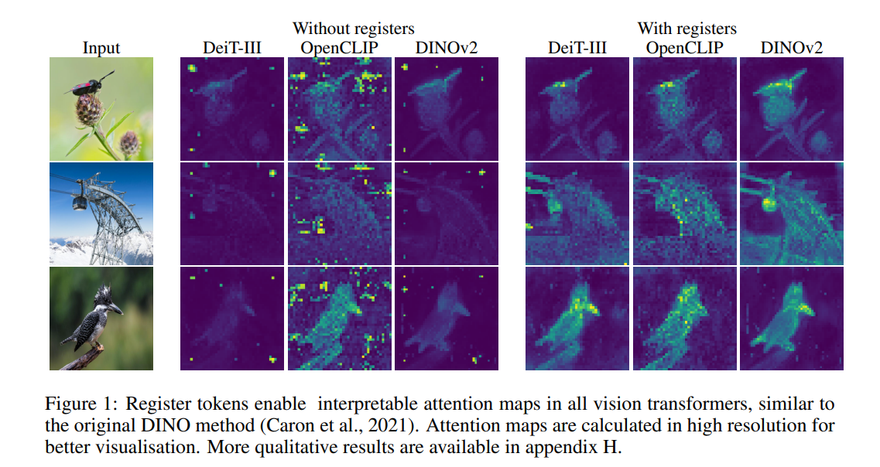
VISION TRANSFORMERS NEED REGISTERS
INTRODUCTION
− Identify and characterize artifacts in feature maps of both supervised and self-supervised ViT networks.
− Propose a simple yet effective solution based on providing additional tokens to the input sequence of the
Vision Transformer to fill that role.

Slide 4
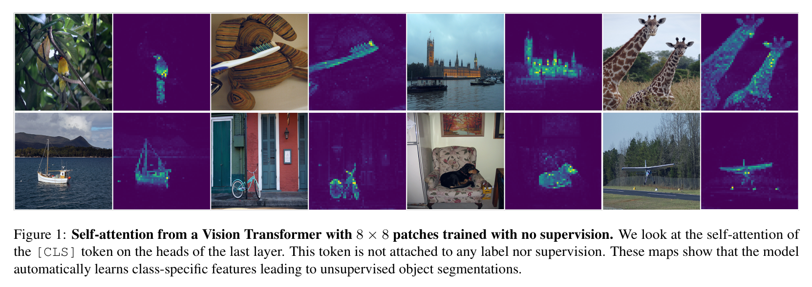
VISION TRANSFORMERS NEED REGISTERS
INTRODUCTION
Embedding images into generic features that can serve multiple purposes in computer vision has been a long-standing problem.
▪ Self-supervised methods building on Transformer: DINO¹
− Self-supervised ViT features explicitly contain the scene layout, especially object boundaries
− Self-supervised ViT features perform particularly well with a basic nearest neighbors classifier (k-NN) without any finetuning,
linear classifier nor data augmentation
1 Caron, M., Touvron, H., Misra, I., Jégou, H., Mairal, J., Bojanowski, P. and Joulin, A., 2021. Emerging properties in self-supervised vision transformers. In Proceedings of the IEEE/CVF international conference on computer vision (pp. 9650-9660).

Slide 5
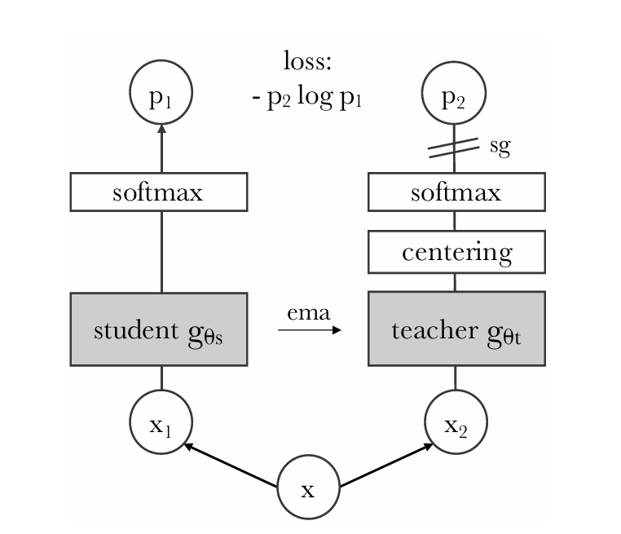
INTRODUCTION
DINO
A simple self-supervised method, self-distillation with no labels
A special case of knowledge distillation, where the student and teacher network have the same architecture.
Each networks outputs a K dimensional feature that is normalized with a temperature softmax over the feature dimension.
We learn the parameters of student network by minimizing loss by SGD and update the teacher parameters with an exponential moving average (ema) of the student parameters.
Generate a set of different views, all crops are passed through the student while only the global views are passed through the teacher, encouraging “local-to-global” correspondences.

Slide 6
INTRODUCTION
DINO
A simple self-supervised method, self-distillation with no labels

Slide 7
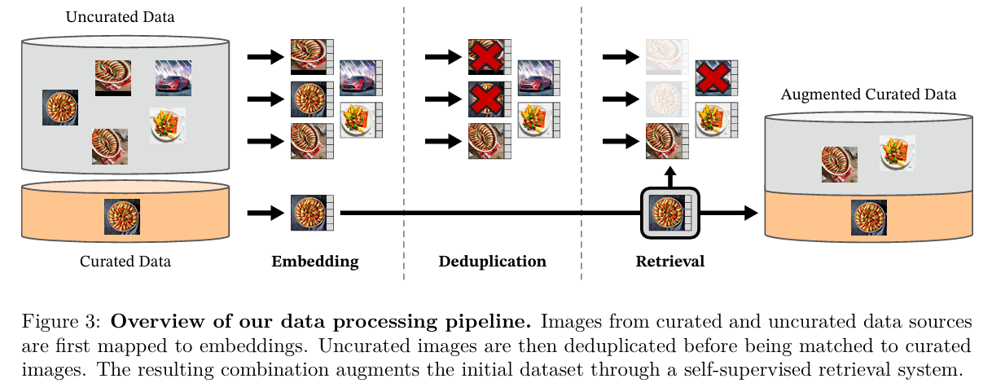
INTRODUCTION
DINOv2
In DINOv2² :
▪ Show that existing pretraining methods, especially self-supervised methods, can produce general visual features if
trained on enough curated data from diverse sources.
▪ Propose an automatic pipeline to build a dedicated, diverse, and curated image dataset.
▪ Train a ViT model and distill it into a series of smaller models that surpass the best available general-purpose features.
2 Oquab, M., arcet, T., Moutakanni, T., Vo, H., Szafraniec, M., Khalidov, V., Fernandez, P., Haziza, D., Massa, F., El-Nouby, A. and Assran, M., 2024. DINOv2: Learning Robust Visual Features without Supervision. Transactions on Machine Learning Research Journal, pp.1-31.
Notes:
For the data: Our selection of curated datasets contains ImageNet-22k, the train split of ImageNet-1k, etc.
Uncurated data source is from a raw unfiltered dataset of images from a publicly available repository of crawled web data.
Deduplication：We apply the copy detection pipeline of Pizzi et al. (2022) to the uncurated data and remove near-duplicate images.

Slide 8
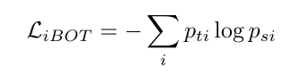
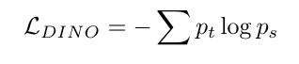
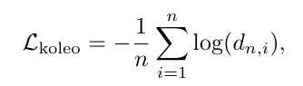
INTRODUCTION
DINOv2
They learn features with a discriminative self-supervised method that can be seen as a combination of DINO and iBOT³ losses with the centering of SwAV⁴. Add a regularizer⁵ to spread features and a short high-resolution training phase.
▪ Image-level objective (DINO loss): ▪ Patch-level objective (iBOT loss):
• KoLeo regularizer:
Efficient implementation:
FlashAttention
Sequence packing
Fully-Sharded Data Parallel
…
3 Zhou, J., Wei, C., Wang, H., Shen, W., Xie, C., Yuille, A. and Kong, T., Image BERT Pre-training with Online Tokenizer. In International Conference on Learning Representations.
4 Caron, M., Misra, I., Mairal, J., Goyal, P., Bojanowski, P. and Joulin, A., 2020. Unsupervised learning of visual features by contrasting cluster assignments. Advances in neural information processing systems, 33, pp.9912-9924.
5 Sablayrolles, A., Douze, M., Schmid, C. and Jégou, H., Spreading vectors for similarity search. In International Conference on Learning Representations.
Notes:
We learn the parameters of the student and build the teacher head with an exponential moving average of past iterates
We randomly mask some of the input patches given to the student, but not to the teacher. We then apply the student iBOT head to the student mask tokens.
FlashAttention, Fully-Sharded Data Parallel (FSDP).

Slide 9
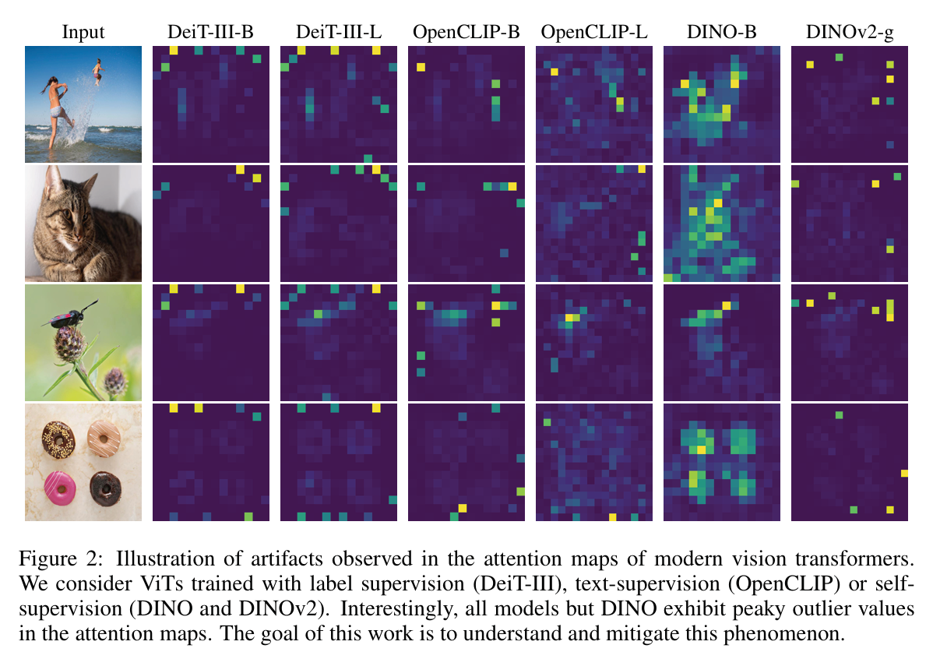
VISION TRANSFORMERS NEED REGISTERS
INTRODUCTION
Despite the strong performance of DINOv2 on dense tasks, it delivers disappointing performance in extracting features.
▪ The artefacts in the feature maps of DINOv2 were not present in the first version of this model.
− Tokens with higher norm
− Around the middle layers
− After a sufficiently long training of a sufficiently big transformer
Understanding this phenomenon…
Notes:
the DINO algorithm is shown to produce models that contain explicit information about the semantic layout of an image. Indeed, qualitative results show that the last attention layer naturally focuses on semantically consistent parts of images and often produces interpretable attention maps.

Slide 10
Thank you
Zhenlin
1/8/2024

